Slide 1
Module 2- Hyperparameter Tuning ,Overfitting and Underfitting

Slide 2
Overfitting and Underfitting: Causes and Solutions
Overfitting occurs when models learn training data too well, struggling with new data
Underfitting happens when models are too simple to capture data patterns
Balancing bias and variance is crucial for optimal model performance
Techniques like cross-validation and data augmentation help prevent overfitting
Simplifying models and increasing training data can address underfitting

Slide 3
Balancing Bias and Variance
Model performance depends on achieving the right balance between bias and variance. Low bias and high variance can lead to overfitting, where the model excels on training data but fails on new data. On the other hand, high bias and low variance result in underfitting, where the model misses the underlying patterns in the data.

Slide 4
The Importance of Generalization
Generalization is vital for a model's real-world application. A well-generalized model can accurately predict outcomes for new, unseen data. This capability distinguishes truly useful models from those that merely memorize training data. To achieve generalization, a balance between underfitting and overfitting is necessary.

Slide 5
What is Overfitting?
Overfitting is a significant issue in machine learning where a model excels on the training data but underperforms on new data. This happens when a model focuses too much on the training set's noise and specific details. As a result, it fails to generalize well.
An overfit model captures both the underlying patterns and the random noise in the training data. This results in a complex model that is poor at predicting on new data. The model's complexity stems from its overemphasis on noise, leading to poor generalization.

Slide 6
Overfitting….
High accuracy on training data
Poor performance on test or validation data
Increased model complexity
Inability to generalize to new scenarios

Slide 7
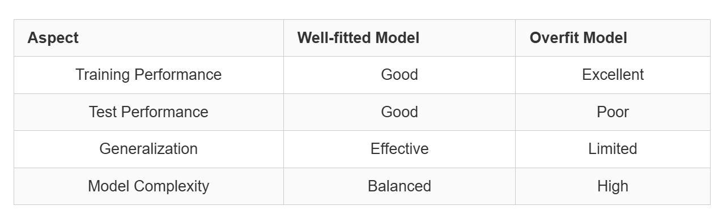
Well-fitted vs overfit models:

Slide 8
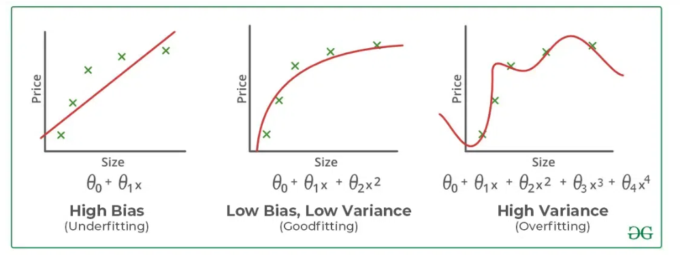

Slide 9
Causes of Overfitting
Overfitting occurs when a machine learning model becomes too precise with the training data. This precision results in poor performance on new, unseen data. Let's delve into the primary causes of overfitting.
Insufficient Training Data
Insufficient training data can lead to models learning specific patterns that don't apply to the broader population. This hinders their ability to generalize. To mitigate this, collect more diverse data or employ data augmentation to expand your dataset.
High Model Complexity
Complex models with numerous features or parameters are more susceptible to overfitting. They tend to capture noise in the training data, resulting in poor generalization. To prevent this, simplify your model architecture or utilize regularization techniques.

Slide 10
Causes of Overfitting
Noisy Training Data
Data quality is essential for model performance. Noisy or irrelevant data in your training set can induce overfitting. Enhance your data quality by removing outliers and focusing on relevant features through careful selection.
Prolonged Training Periods
Training your model for extended periods can also lead to overfitting. The model may start to memorize specific patterns in the training data rather than learning generalizable features. Monitor your training duration and employ early stopping techniques to avert this issue.

Slide 11
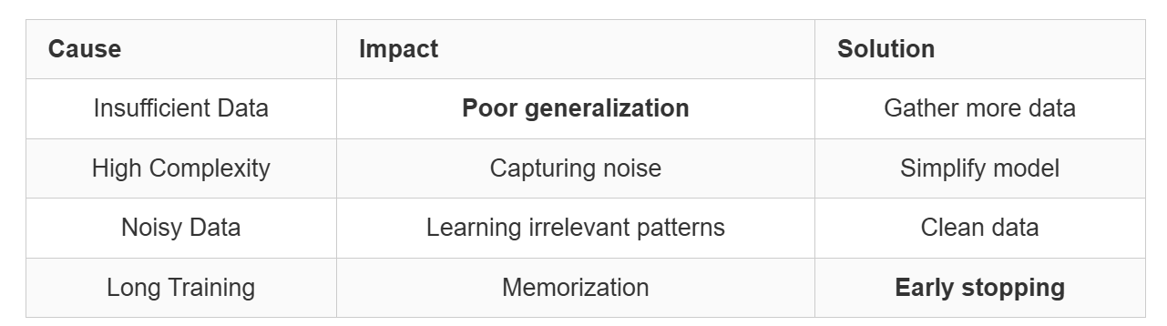

Slide 12
Detecting Overfitting
Identifying overfitting in machine learning models is essential for making accurate predictions. It requires thorough model evaluation and the analysis of performance metrics.
Performance Gap Between Training and Test Data
A large gap in performance between training and test data signals overfitting. If your model excels on training data but falters on test data, it might be overfitting. This disparity implies the model has simply memorized the training examples rather than discovering broader patterns.
Cross-Validation Techniques
K-fold cross-validation is a vital tool for identifying overfitting. It divides your dataset into subsets, trains on some, and validates on others. This approach offers a comprehensive assessment of your model's performance across varied data segments.

Slide 13
Detecting Overfitting
Learning Curves Analysis
Examining learning curves can expose overfitting patterns. These curves depict how training and validation errors evolve as the model learns. Learning curves that show a divergence, with training error decreasing but validation error rising, typically signify overfitting.

Slide 14
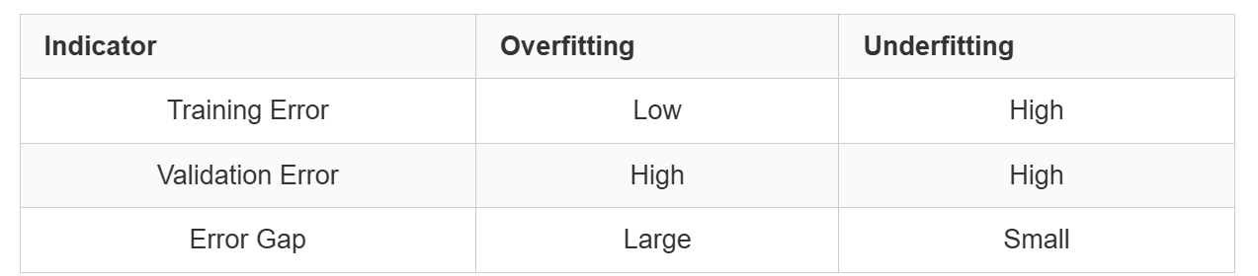

Slide 15
Strategies to Prevent Overfitting
Overfitting happens when a model learns too much from the training data, reducing its ability to handle new information. To fight this, several techniques are available. Regularization is a primary method that makes complex models less complex, enhancing their ability to generalize. Early stopping is another strategy, stopping training when the model starts to learn noise.
Data augmentation is vital in preventing overfitting. It increases the diversity of the dataset, making the model more resilient. For example, in image recognition, you might flip, rotate, or add noise to images to expand the training set.

Slide 16
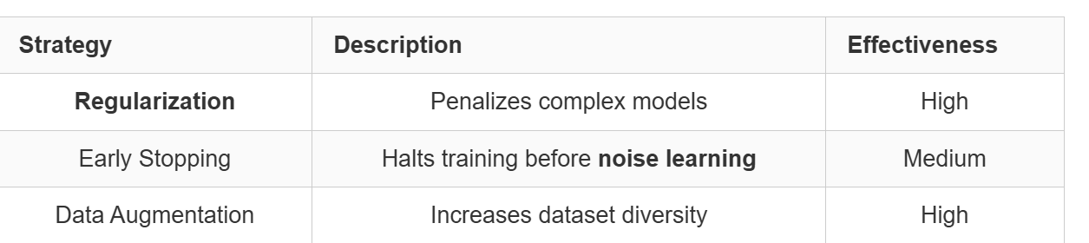
Other strategies include simplifying the model's architecture and using dropout layers.
Increasing the training set size and also helps reduce the risk of overfitting.

Slide 17
What is Underfitting?
Underfitting happens when a machine learning model misses the underlying patterns in the data. This leads to poor performance on both the training and test sets. Such models fail to learn even the basic relationships, resulting in inaccurate predictions.
Characteristics of Underfit Models
Underfit models show high bias and low variance. They often come from overly simple architectures or not enough training. These models make too general assumptions about the data, missing key details.
Simplistic model structure
Inability to capture complex relationships
High error rates on training and test data

Slide 18
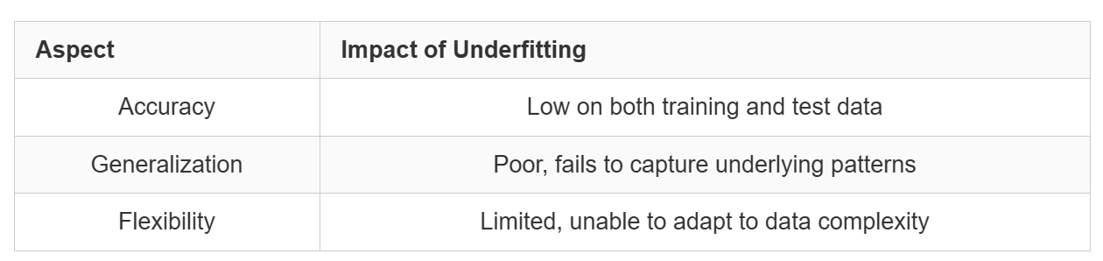
Impact on Model Performance
The effects of underfitting are severe. Models with high bias do not perform well on any dataset, failing to make accurate predictions or insights. Their simplicity prevents them from solving even simple problems effectively.

Slide 19
Addressing Underfitting in Machine Learning Models
Underfitting happens when a model doesn't capture the data's complexity. To fix this, several strategies can boost model performance. Feature engineering is key in enhancing accuracy. By creating new features or transforming old ones, the model can discover hidden patterns in the data.Increasing model complexity is another effective method. This might mean adding more layers to neural networks or deepening decision trees. As you increase model complexity, watch out for the risk of overfitting.Longer training times often lead to better outcomes. Allowing the model more time to learn from the data helps it understand underlying patterns better. Hyperparameter tuning is also crucial. Adjusting parameters like learning rate or regularization strength can greatly affect model performance.
Increase model complexity
Perform feature engineering
Extend training duration
Fine-tune hyperparameters
Addressing underfitting is an ongoing process. You might need to use several techniques together for the best results. By applying these strategies carefully, you can improve your model's ability to capture complex relationships in the data and boost its overall performance.

Slide 20
Hyperparameter Tuning
Hyperparameter tuning is the process of selecting the optimal values for a machine learning model’s hyperparameters. Hyperparameters are settings that control the learning process of the model, such as the learning rate, the number of neurons in a neural network, or the kernel size in a support vector machine. The goal of hyperparameter tuning is to find the values that lead to the best performance on a given task.
What are Hyperparameters?
In the context of machine learning, hyperparameters are configuration variables that are set before the training process of a model begins. They control the learning process itself, rather than being learned from the data. Hyperparameters are often used to tune the performance of a model, and they can have a significant impact on the model’s accuracy, generalization, and other metrics.
Different Ways of Hyperparameters Tuning
Hyperparameters are configuration variables that control the learning process of a machine learning model. They are distinct from model parameters, which are the weights and biases that are learned from the data. There are several different types of hyperparameters:

Slide 21
Hyperparameters in Neural Networks
Neural networks have several essential hyperparameters that need to be adjusted, including:
Learning rate: This hyperparameter controls the step size taken by the optimizer during each iteration of training. Too small a learning rate can result in slow convergence, while too large a learning rate can lead to instability and divergence.
Epochs: This hyperparameter represents the number of times the entire training dataset is passed through the model during training. Increasing the number of epochs can improve the model’s performance but may lead to overfitting if not done carefully.
Number of layers: This hyperparameter determines the depth of the model, which can have a significant impact on its complexity and learning ability.
Number of nodes per layer: This hyperparameter determines the width of the model, influencing its capacity to represent complex relationships in the data.
Architecture: This hyperparameter determines the overall structure of the neural network, including the number of layers, the number of neurons per layer, and the connections between layers. The optimal architecture depends on the complexity of the task and the size of the dataset
Activation function: This hyperparameter introduces non-linearity into the model, allowing it to learn complex decision boundaries. Common activation functions include sigmoid, tanh, and Rectified Linear Unit (ReLU).

Slide 22
Hyperparameter Tuning techniques
Models can have many hyperparameters and finding the best combination of parameters can be treated as a search problem. The two best strategies for Hyperparameter tuning are:
GridSearchCV
RandomizedSearchCV
Bayesian Optimization

Slide 23
1. GridSearchCV
Grid search can be considered as a “brute force” approach to hyperparameter optimization. We fit the model using all possible combinations after creating a grid of potential discrete hyperparameter values. We log each set’s model performance and then choose the combination that produces the best results. This approach is called GridSearchCV, because it searches for the best set of hyperparameters from a grid of hyperparameters values.
An exhaustive approach that can identify the ideal hyperparameter combination is grid search. But the slowness is a disadvantage. It often takes a lot of processing power and time to fit the model with every potential combination, which might not be available. Drawback: GridSearchCV will go through all the intermediate combinations of hyperparameters which makes grid search computationally very expensive.

Slide 24
2. RandomizedSearchCV
As the name suggests, the random search method selects values at random as opposed to the grid search method’s use of a predetermined set of numbers. Every iteration, random search attempts a different set of hyperparameters and logs the model’s performance. It returns the combination that provided the best outcome after several iterations. This approach reduces unnecessary computation.
RandomizedSearchCV solves the drawbacks of GridSearchCV, as it goes through only a fixed number of hyperparameter settings. It moves within the grid in a random fashion to find the best set of hyperparameters. The advantage is that, in most cases, a random search will produce a comparable result faster than a grid search. Drawback: It’s possible that the outcome could not be the ideal hyperparameter combination is a disadvantage.

Slide 25
3. Bayesian Optimization
Grid search and random search are often inefficient because they evaluate many unsuitable hyperparameter combinations without considering the previous iterations’ results. Bayesian optimization, on the other hand, treats the search for optimal hyperparameters as an optimization problem. It considers the previous evaluation results when selecting the next hyperparameter combination and applies a probabilistic function to choose the combination that will likely yield the best results. This method discovers a good hyperparameter combination in relatively few iterations.
Data scientists use a probabilistic model when the objective function is unknown. The probabilistic model estimates the probability of a hyperparameter combination’s objective function result based on past evaluation results.
P(score(y)|hyperparameters(x))

Slide 26
Advantages of Hyperparameter tuning:
Improved model performance
Reduced overfitting and underfitting
Enhanced model generalizability
Optimized resource utilization
Improved model interpretability

Slide 27
Disadvantages of Hyperparameter tuning:
Computational cost
Time-consuming process
Risk of overfitting
No guarantee of optimal performance
Requires expertise

